Slide 1
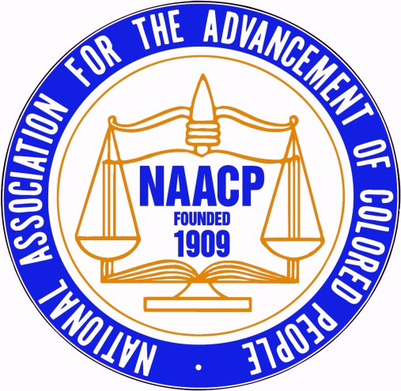
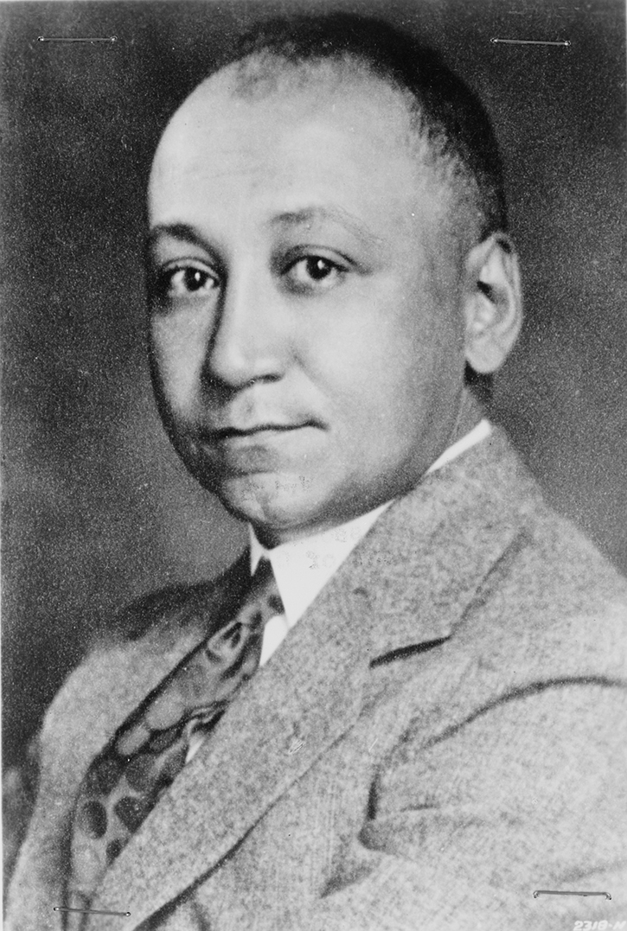
Dr. Louis Tompkins Wright
Physician | Advocate | Leader
Notes:
Sources:
http://prod.myloc.gov/Exhibitions/naacp/newnegromovement/ExhibitObjects/LouisTompkinsWright.aspx?Enlarge=true&ImageId=6369c94f-71f9-4d10-b75b-3cd13e4ac4ec%3Aaf587318-8ba4-4085-ad4a-3df7b091a6f6%3A73&PersistentId=1%3A6369c94f-71f9-4d10-b75b-3cd13e4ac4ec%3A11&ReturnUrl=%2FExhibitions%2Fnaacp%2Fnewnegromovement%2FExhibitObjects%2FLouisTompkinsWright.aspx
http://naacptristateinu.org/

Slide 2
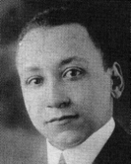
Early Biographical Info
Born July 23, 1891, La Grange, GA ¹
Son of Dr. Ceah Kentchen Wright²
B.A. from Clark University (Atlanta, GA) ¹
M.D. from Harvard Medical School ³
Source: http://www.aaregistry.org/
historic_events/view/louis-t-wright-surgeon-and-naacp-chairman
Notes:
Father was born into slavery, eventually valedictorian physician-graduate of Meharry Medical College
Clark University – HBC in Atlanta, founded in 1869 by the Freedman’s Aid Society of the Methodist Episcopal Church → now Clark Atlanta University
B.A. in 1911 – valedictorian
M.D. in 1915, graduated 4th in class

Slide 3
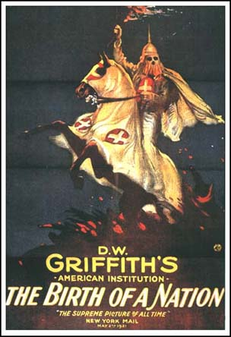
Early Activism
Missed three weeks of school to picket screenings of “The Birth of a Nation”⁴
Objected to discrimination when professor attempted to prevent him from delivering babies at a white teaching hospital²
Began dispelling race-based science as a intern at Freedman’s Hospital⁶
Source: https://animation
begins.wordpress.com/tag/the-birth-of-a-nation/
Notes:
- At the Boston Lying-In Hospital

Slide 4
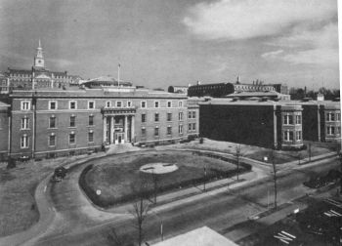
EARLY Professional Career
Unable to win an internship at one of Boston’s many hospitals
Postgraduate internship at Freedman’s Hospital
Returned to Atlanta, went into practice with stepfather ²
Source: http://www.blackpast.org/
aah/freedmen-s-hospital-howard-university-hospital-1862
Notes:
Despite graduating 4th in his class
Completed internship in 1916
Stepfather = William Fletcher Penn, 1st black graduate of Yale School of Medicine
Joined NAACP at that time

Slide 5
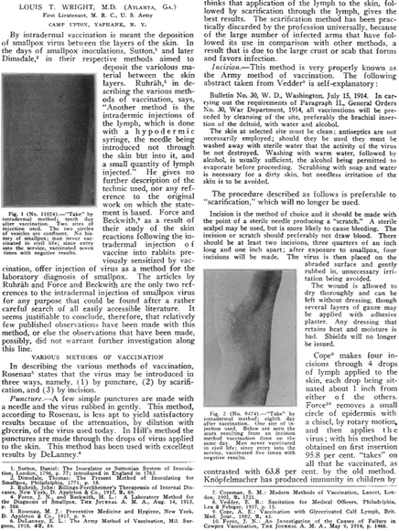
Military Service
1st Lieutenant in the Army Medical Corps in WWI ²
Ran a field hospital in France
Intradermal vaccine for smallpox
Gassed & awarded the Purple Heart ⁴
Source: http://jama.jamanetwork.com/data/
Journals/JAMA/5547/jama_71_8_011a.pdf
Notes:
U.S. entered WWI in 1917
Intradermal vaccination = “deposition of smallpox virus between the layers of the skin
Smallpox: France = 576 deaths (eradicated in 1936), UK = 64 deaths (eradicated in 1934), Germany = 1323 (eradicated in 1922) [http://whqlibdoc.who.int/smallpox/9241561106_chp8.pdf]

Slide 6
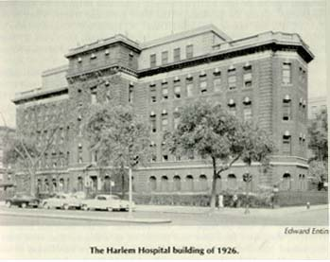
Harlem Hospital
Opened small, private practice in Harlem, New York - 1919
Practice became affiliated with Harlem Hospital
Hired as medical personnel for HH outpatient clinic ⁵
1925: Wright & four others appointed to inpatient staff ⁶
Source: http://northbysouth.kenyon.edu
/1998/health/hospny.htm
Notes:
1st African American on surgical staff of hospital
Appointed to the lowest position in the clinic
Superintendent was forced to transfer elsewhere
Patients were 75% black in 1920, staff registered 100% white

Slide 7
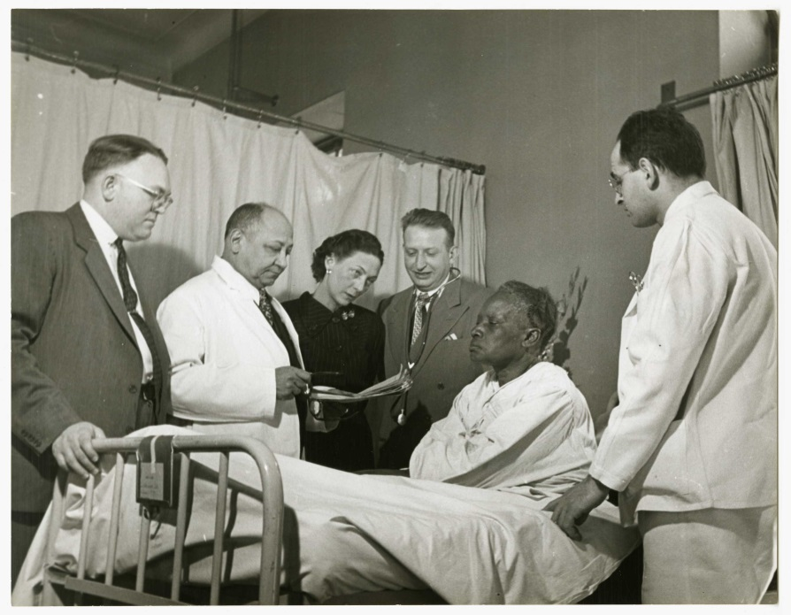
Later Professional Career
1929: NYPD names Wright police surgeon²
1934: Fellow of the American College of Surgeons⁴
1935: Chair of the N.A.A.C.P. Board of Directors
1938: Director of Attending Surgeons & Director of the Medical Board³
Louis T. Wright
Source: http://repository.countway.harvard.
edu/xmlui/handle/10473/3468

Slide 8
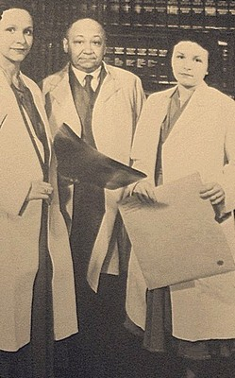
Later Activism
Vocal proponent of a fully-integrated HH
Opponent of privately-funded “charity” hospitals³
Advocate for stringent medical education standards²
- “What the Negro physician needs is equal opportunity for training and practice – no more, nor less”³
Testified about the Hill-Burton Hospital Survey and Construction Act
1944: formed NAACP’s “National Medical Committee” – provided expert advice for policy making, etc⁸
Source: http://mrmhadams.typepad.
com/blog/2013/03/some-harlem-women-who-helped-make-black-beautiful.html
Notes:
Felt that charity hospitals would excuse the city from its obligation to the underserved population of Harlem
1926: first black interns
1930: hospital staff = fully integrated b/c completely new medical board → replaced 12 white MDs with black
New board assigned black MDs according to qualifications → Wright was named secretary of the medical board
Faced opposition from the black medical establishment – had grown accustomed to separate and sometimes less rigorous schools
Nat’l Medical Committee – created nat’l health program and built consensus for racial integration of healthcare

Slide 9
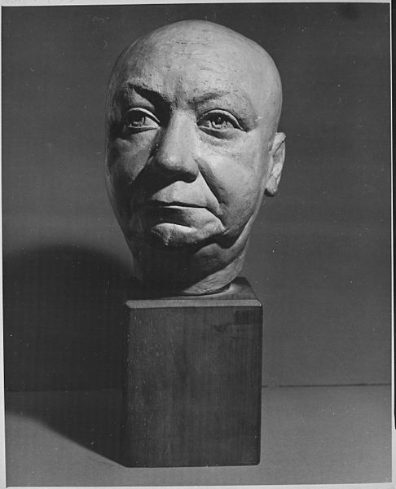
Other accomplishments
Started the Harlem Hospital Bulletin
Founded HH’s cancer research⁷
1945: NAACP’s Spingarn Medal
HH renamed its library the “Louis Tompkins Wright Library”⁸
89 scientific papers – first use of Aureomycin^{2,7}
Source: http://en.wikipedia.org/wiki
/File:%22Head_of_Dr._Louis_Wright%22_-_NARA_-_559035.jpg
Notes:
1st African American on surgical staff of hospital
Medal – for pushing for improving the quality of residency and medical care

Slide 10
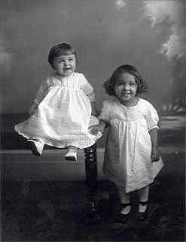
Later Biographical Details
1918: Married Corrinne M. Cooke
Two daughters:
- Jane Cooke Wright
- Barbara Wright Pierce¹
Death in 1952 following a heart attack, complications due to TB²
Source: http://mrmhadams.typepad.com/
blog/2013/03/some-harlem-women-who-helped-make-black-beautiful.html
Notes:
Jane: Attended NY Medical College, graduating in 1945 → 3 year program due to WWII
Internship at Bellevue Hospital (NYC), residency at Harlem Hospital
Became respected cancer researcher
Lungs never recovered from WWI → TB attacks from 1939 – 1942
Age 62

Slide 11
Works Cited
1) Wright, Jane Cooke (2008). Encyclopedia of World Biography. Retrieved from http://www.encyclopedia.com/doc/1G2-2506300181.html
2) Appiah, K.A. and Gates, Jr., H.L. (2005). Civil Rights: An A-to-Z Reference of the Movement That Changed America. Retrieved from Google Books
Louis T. Wright, MD. North by South: The African American Great Migration. Retrieved from http://northbysouth.kenyon.edu/1998/health/wright.htm
Medicine: Negro Fellow (1934, Oct. 29). Time Magazine. Retrieved from http://content.time.com/time/magazine/article/0,9171,882266,00.html
Clinical Medicine in Harlem. North by South: The African American Great Migration. Retrieved from http://northbysouth.kenyon.edu/1998/health/hospny.htm
Carey, Jr., C.W. (2008). African Americans in Science: An Encyclopedia of People and Progress. Retrieved from Google Books.

Slide 12
Works Cited (Cont’d)
7) Louis Wright. Retrieved from http://faculty.washington.edu/qtaylor/aa_Vignettes/wright_louis.htm
8) Reynolds, P. R. (2000). Dr Louis T. Wright and the NAACP: Pioneers in Hospital Racial Integration. The American Journal of Public Health, 90(6):883

