Slide 1
Dr. Benjamin Solomon Carson Sr.

Slide 2
Honors and Awards
Awarded the Presidential Medal of Freedom in 2008
Member of the Academy of Achievement
Member of the Horatio Alger Association of Distinguished Americans
Awarded the Ford’s Theater Lincoln Medal
Alpha Omega Alpha Medical Honor Society
Received more than 40 Honorary doctorate degrees
Selected as one of 89 Living Legend by the Library of Congress in 2001
Recipient of the Spingarn Medal in 2006

Slide 3
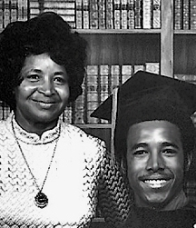
Early Life
Born September 18, 1951 in Detroit, Michigan
Second son of Sonya and Robert Solomon Carson
Ben was raised by his mother, who herself was raised in Tennessee and dropped out of school in the third grade
Married at the age 13
Sonya moved to Detroit with her husband, a Baptist Minister, but her husband soon became unreliable and very domineering so they divorced for the good of her sons, Ben was 8.
His mother often worked multiple jobs as domestic servants and other very low income jobs.
She would work almost 20-hour workdays so her sons would almost not see for days at a time.

Slide 4
Early Life
His Mother was very frugal with the finances and would patch clothes from Goodwill, go to local farms and offer to pick corn or other vegetables in exchange for a small portion of the yield.
Because the family was on medical assistance, they would have to wait for hours to be seen by an intern at the hospital.
Ben would imagine his name “Dr. Carson” being called from the PA system and this provided one of the bases of interests he had in the field of medicine.

Slide 5
Early Education
Ben and his brother both experienced difficulty in school
Ben became the object of ridicule by his classmates and soon developed a violent and uncontrollable temper and was known to attack his classmates even at being provoked in the slightest.
He found solace in the Book of Proverbs.

Slide 6
Early Education
Sonya Carson intervened and turned around her sons’ behavior and academic success by limiting their television time, introducing God into their lives, demanding homework completion before going outside.
She required her sons to read two books a week and give her written reports and even though she herself could barely read.
Ben’s early resentment of this extracurricular assignment turned to a desire to read and learn more.

Slide 7
Early Education
Ben delved into science and technical books and soon discovered he could become a scientist or physician, which at first seemed a fantasy or part of his overactive imagination.
With this new hunger for learning and interest in science, Ben eventually rose to the top of his class and a few of his teachers took interest in his rise and helped nurture this growing interest in school and the sciences.
He started to face numerous situations of racism and even one of his teachers criticized Ben’s white classmates for letting a Black kid outshine them.
“If walk into an auditorium full of racist, bigoted people… you don’t have a problem, they have a problem.”

Slide 8
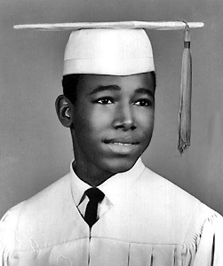
High Education
After graduating from High School with honors, thinking back to the sermons his pastor used to give about medical missionaries, Ben knew he wanted to pursue a career in medicine.
Financially he knew his mother could not support the expenses so he had to work most of his time in college.
He was finally able to get a job where he could attend school and support himself.
He graduated from Yale in 1973 with his B.A., majoring in Psychology, then enrolled in the School of Medicine at the University of Michigan

Slide 9
Higher Education
Ben decided to become a neurosurgeon rather than a psychologist.
He married Lacena Rustin whom he met at Yale; they had three children
1977 Ben earned his medical degree. He and his wife moved to Maryland where he became a resident at Johns Hopkins University
By 1982 Ben worked his way up to being the chief resident in neurosurgery at Johns Hopkins
He noted in an interview that being a young African American male didn’t make his work environment any easier. His early days as a surgeon the nurses would often mistake him for a hospital orderly because the only black man they’ve seen with scrubs in that ward on was an orderly.

Slide 10
Medical Career
1983, Dr. Carson was invited to Perth, Australia because they needed a neurosurgeon
In Australia there was such a shortage of doctors with his skill and training, so he was able to gain years worth of experience in a short time
“In my one year there…my skills were honed…and I felt capable and comfortable working on the brain.”
He performs his procedures with the music of Bach, Schubert and other composers to keep him calm
He returned to Johns Hopkins in 1984, and 1985 he became the director of pediatric neurosurgery .
He soon faced many challenging cases; Hemispherectomy on 4yr old Maranda Franciso
Binder Siamese Twins, Patrick and Benjamin
Makwaeba twins, South Africa 1994
Matthew’s Miracle
Performed 500 operations a year, almost 3 times as many as most neurosurgeons

Slide 11
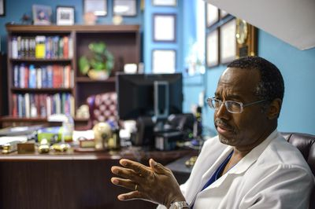
Medical Career
2002 he developed prostate cancer so cut-back on surgeries and took on more of a consulting role
He now limits himself to about 300 operations a year. He has authored 5 Books, Gifted Hands (1990), The Big Picture (2000), Think Big (1996), Take the Risk (2007), and American the Beautiful (2012)
This summer at the age of 61, Ben Carson plans on retiring as a surgeon
Ladan and Laleh Bijani, 29 years old twins joined at the head, they lived together so long at they would rather die than spend another day together
2003, the 52-hour operation was underway, they used a 3-D imaging technique Carson had developed several years earlier
The twins had lost a large amount of blood during the surgery due to complication and soon they both died but Dr. Carson recognized them for their bravery to pursue the operation

