Slide 1
Dr. Matilda A. Evans Michal Ande AAS Final 4/29/13

Slide 2
Background
Born on May 13, 1872 in Aiken, South Carolina
Died on November 17, 1935
The daughter of Anderson and Harriet Evans
The oldest of 3 kids

Slide 3
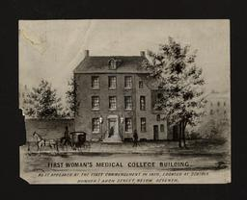
Schooling
Learned under Martha Schofield at the Schofield Industrial School
Went on to attend Oberlin College in Ohio and graduated in 1891
Graduated with an M.D. from the Women’s Medical College of Penn in 1897

Slide 4
Major Accomplishments
First African American women to practice medicine in South Carolina
Established two hospitals in South Carolina to treat her patients
Also established a Nurse training school
Established The Negro Health Association of South Carolina

Slide 5
Service to the Community
Offered Obstetrics, Gynecology, Pediatrics, Hygienics and surgery to women in Columbia, South Carolina
Because many wealthy white women paid her very well for her services she was able to give care to poor black women and their children for free
Opened the Taylor Lane Hospital

Slide 6
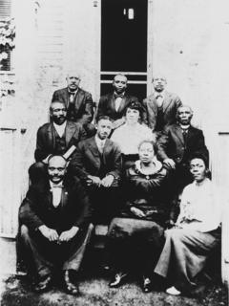
Service to the Community
Provided care to women who did not want their condition being found out by the social circle
Established a community health organization in Columbia.
Established a Community Center called Dr. Evan’s Park & Swimming pool in her community
Established the Columbia Clinic Association
Notes:
Columbia Clinic Association provided health services like vaccinations and check-ups and health education to impoverished and poor families

Slide 7
Service to the Community
Did a survey of African American school children in Columbia and found the major gap in their health care
Used this to establish routine health examinations in the schools in Columbia
After the Taylor Lane Hospital and Nurse Training school burnt down she established the St. Luke’s Hospital and Nurse Training School.
Notes:
Stayed afloat financially by hiring out nurses, white business men, wealthy white women and volunteer service of young white physicians & from student nurses

Slide 8
Personal Life
Adopted 7 children
Foster mom to over two dozen children who were left at her hospitals.
Religious woman who served as a chair of the council in her Episcopal Church.
Worked on her own land as well.
Her personal life was dedicated to the same goals as her professional life was.

Slide 9
Organization Involvement
Established the Negro Health Association of South Carolina & Negro Health Journal of South Carolina
Served on the State Medical Association
Regional Vice President of the National Medical Association
Worked on the Volunteer Medical Service Corps
Worked to meet the demand for medical services at home during World War I
President of the Palmetto Medical Association in 1922

Slide 10
Why Is She Important to the Advancement of Blacks in Medicine?
Matilda Evans would go out of her way to get Black women the education that she was lucky enough to receive
She wrote Alfred Jones to get a few women scholarships
She opened training schools and hospitals in order to give African American women the training that they could not get in the South.
She worked tirelessly at educating African Americans where she lived about health care and worked to bridge the gap in their access and quality of care.
She worked to draw attention to the unacceptably low health care of the African American population in her community and also in South Carolina.

