Slide 1
Interview with Victor Lightfoot, DDS
By Jordan Lassiter

Slide 2
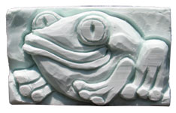
Childhood
Born in Dayton, Ohio in 1925
Only child growing up
Recalls always being very crafty

Slide 3
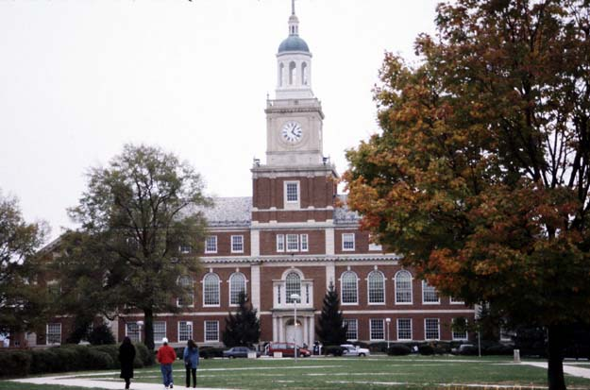
College
Attended one year of college at Howard before being drafted to serve in WWII
After 3 years in the military, he returned to college, joined a fraternity, and was accepted to medical school

Slide 4
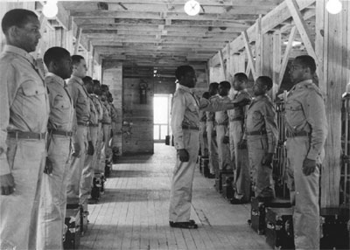
MILITARY Experience
Served in a segregated unit
Interest in medicine led to Medical Department
Often found himself in hospitals

Slide 5
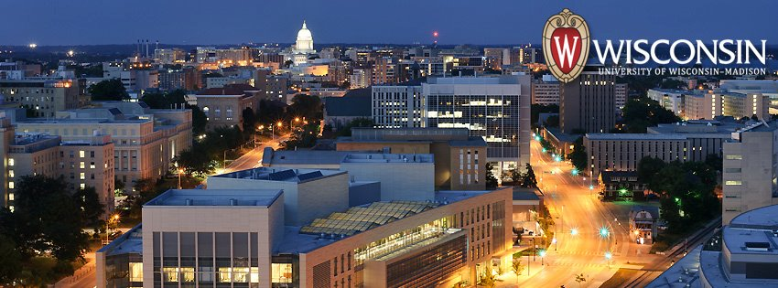
Medical School
Attended The University of Wisconsin in 1944
Could not stand experience
Returned to Howard to pursue other options

Slide 6
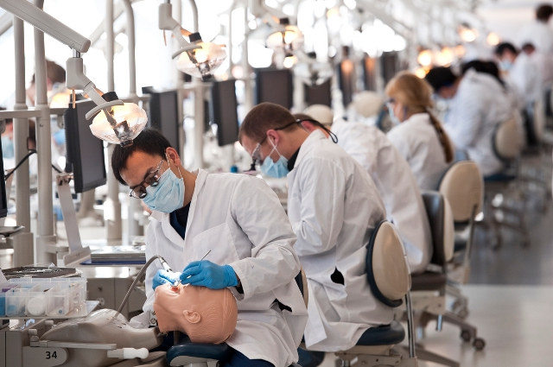
Dental School
Attended Dental School at Howard after pleading for admission
Finished top of his class – Received Deans Award
Had the opportunity to serve the oral surgery clinic at Freedman’s Hospital

Slide 7
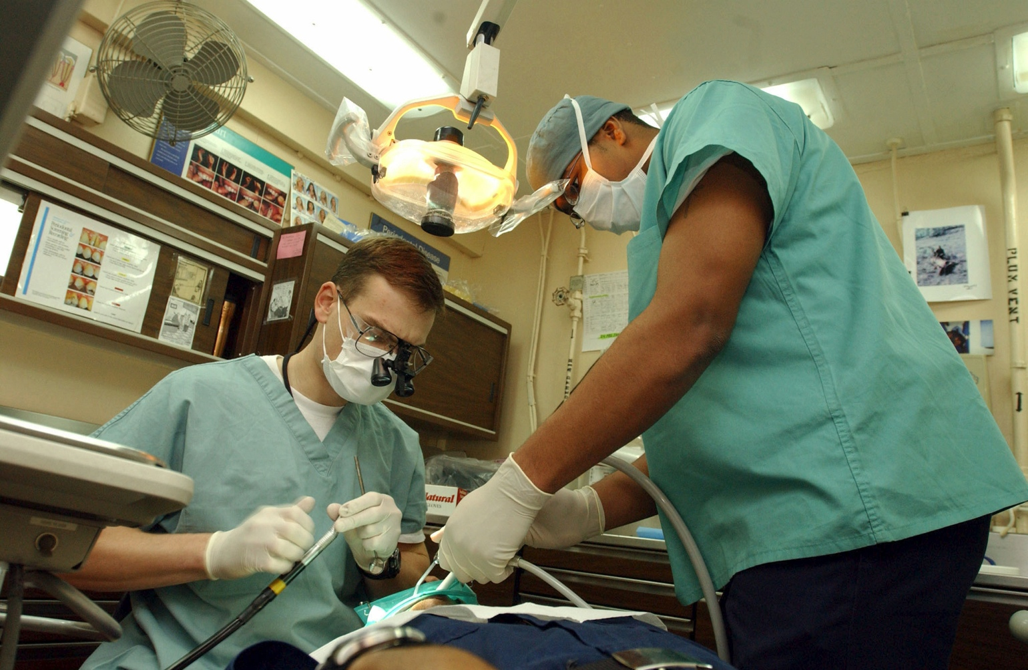
Private Practice
Practiced for 20 years in Ohio and then another 20 years in New Jersey (1955-1995)

Slide 8
Healthcare/ Dentalcare Progression
We are moving in the right direction, however Dr. Lightfoot believes he is not suited for the current medical/dental world
Healthcare is faster and completely automated
Insurance based healthcare
Full integration

