Slide 1
The Making of Health Professionals: Rise of Surgeons (Specialists)
Created By: Bethel Yeshiwas

Slide 2
EARLY SPECIALIST CERTIFICATIONS
Specialty | First Black Surgeon Certified | Date Certified
Otorhinolaryngology | William Harry Barnes Philadelphia, PA | May 16, 1927
Obstetrics & Gynecology | Peter Marshal Murray New York City | 1931
Ophthalmology | Chester W. Chinn New York City | 1933
Urology | Richard Francis Jones Washington, D.C. | December 6, 1936
General Surgery | Roscoe Conkling Giles Chicago, IL | October 29, 1938
Orthopedic Surgery | James Robert Gladden Washington, D.C. | January 22, 1949
Thoracic Surgery | James Richard Laurey Washington, D.C. (founding member) | 1949
Neurological Surgery | Clarence S. Greene Washington, D.C. | October 22, 1953

Slide 3
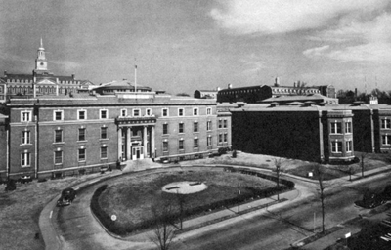
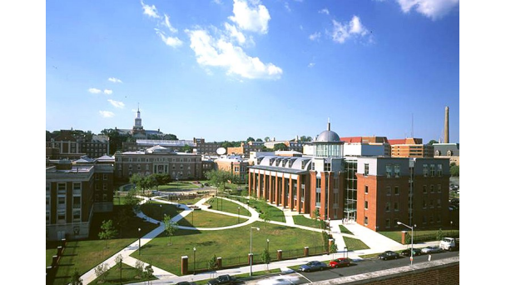
Howard Story
The Old Freedmen’s Hospital
Major Events
1868: Department of Surgery established
1935: Surgical residency program established with Charles R. Drew and James Richard Laurey as assistants in surgery
1943: Surgical laboratories open
1944: First resident affiliation initiated by Dr. Drew
1949: General Surgery Residency Program approved
The New Howard University Hospital

Slide 4
Austin M. Curtis, M.D.
Professor and Chairman
1898 First Black Head of Surgery Department

Slide 5
Residency Program
First two residents (pediatrics and OBGYN) authorized 1935, Program began in 1936
Medicine, obstetrics, gynecology, pediatrics, and surgery
Pioneer students had high ambition for this training program
Dr. John B. Manly—first surgical resident
1938
Early plan of resident training in surgery consists of two full years of rotation in various divisions of surgery and one year of working as an assistant in surgery
Three years of training total

Slide 6
What’s their story?
William Harry Barnes (Left), Clarence S. Greene (Right)

Slide 7
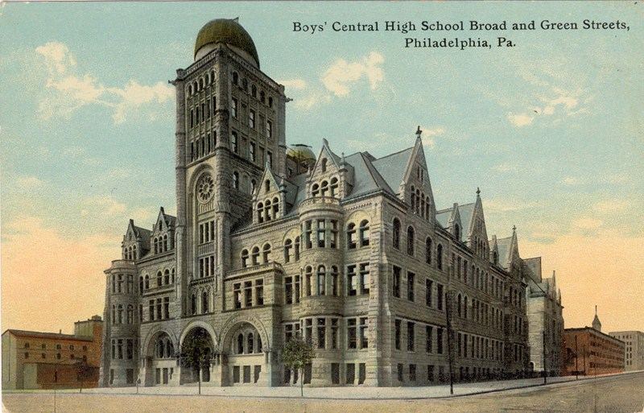
William Harry Barnes
Early Life
Born in 1887 to poor parents, grew up in the black ghetto of Philadelphia
Walked to school-10miles
Work: porter and messenger for a jewelry store
“Failure is from within.”

Slide 8
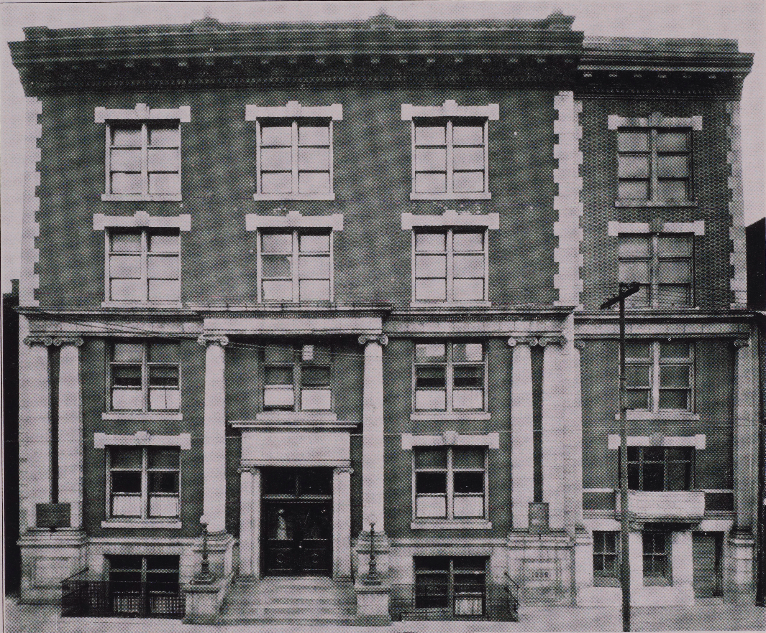
Continued Education
Medical School—
Won a scholarship to attend University of Pennsylvania Medical School
Graduated: 1912
Post Doctoral Training—Internship at Frederick Douglass Memorial Hospital, PA
Otolaryngology interest

Slide 9
Later Years
1913: Assistant Otolaryngologist
After seven years of clinical experience in active practice, seeks more education
Postgraduate course in operative surgery of ear, nose, and throat (1921)
Travels to Paris
Desired further training; University of Paris and Bordeaux

Slide 10
Society for the Promotion of Negro Specialist in Medicine (S.P.N.S.M),
Mission: to stimulate, encourage, assist and promote the development of specialists among the Negro medical profession.
Written Charter detailing qualifications for membership and the requirements associated with being a member
Key Element: offered seminars free of charge led by faculty for each respective specialty: surgery, internal medicine, neurology, psychiatry, gynecology, etc.

Slide 11
Membership
Philadelphia Academy of Medicine and Allied Science, serving as president for three years
American Laryngological Society
American Medical Association
Philadelphia Medical Society
Committee on the Conservation of Hearing
1935—1936 Served as the 37th president of the National Medical Association

Slide 12
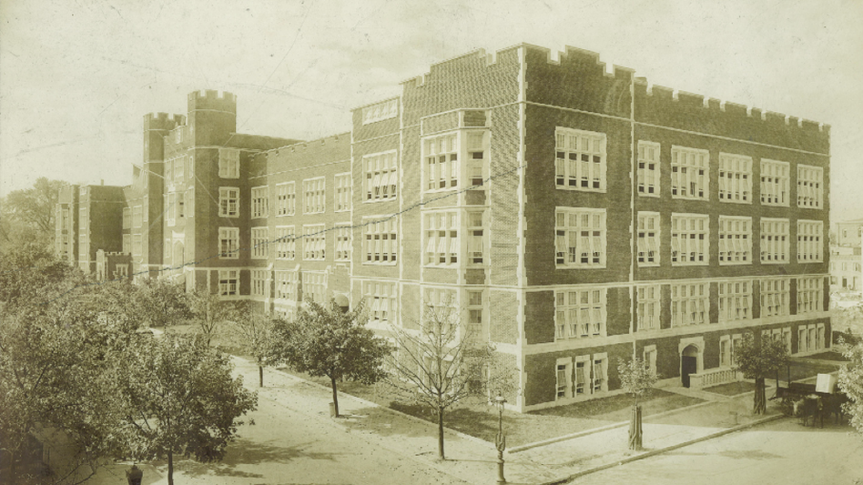
Clarence S. Greene
Early Life
Born on December 26, 1901 in Washington, D.C.
Paul Laurence Dunbar High School
Affluent family background
Relatives are physicians
Main medical figures

Slide 13
Continued Education
University of Pennsylvania and then continued onto their Dental School
D.D.S. degree in 1926
Harvard University: 2 year premedical training program (from 1927-29)
1930: Internship at Cleveland City Hospital
Back to UPENN
Earned a Bachelor of Arts degree (1932)
1936—received M.D. at the College of Medicine at Howard University

Slide 14
Later Years
1937-1939 Residency program in Douglass Hospital in Philadelphia under Dr. John P. Turner
Freedmen’s Hospital in Washington D.C. for two years
Worked as an assistant resident under Dr. Edward L. Howes
1943: Assistant professor of surgery at Howard
First black Howard graduate and Howard trained surgeon to pass the latter board

Slide 15
Establishing Howard’s Division of Neurosurgery
1947-1949 Greene decided to travel to Europe to receive even more schooling
World-renowned Montreal Neurological Institute of McGill University
Receiving high praise from Dr. Penfield
First African-American certified by the American Board of Neurological Surgery on October 22, 1953
Chief of Howard’s newly established Division of Neurosurgery with the rank of assistant professor

Slide 16
Contributions
Pioneering many of Freedmen’s Hospital’s surgical procedures: intracranial aneurysms, brain tumors, herniated intervertebral discs and sympathectomies for hypertension as well as other routine diagnostic procedures
1953—first African American to be appointed diplomat of the American Board of Neurosurgery
1955, named head of the Department of Surgery
Tragic Death in 1957

