Slide 1
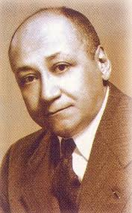
Dr. Louis T. Wright
Awura ama oduro

Slide 2
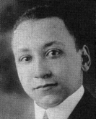
Early Years- Family
Born on July 23, 1981 in Georgia.
Both grandfathers were white.
His father, who was born a slave, had his formal education at Haven Normal School, Clark University and later Meharry Medical School.
His father, Ceah K. Wright, was both a physician and a minister.
His mother, Lula Tomkins taught sewing at Thayer home.
Louis had an older brother, who died at the age of 10.
His mother remarries a physician and surgeon, Dr. William Fletcher Penn.

Slide 3
Professional Education
Graduated from Clark University as valedictorian.
Accepted into Harvard University Medical School
Wright started getting involved with activism in his third year at Harvard. (Picketing)
Successful research on effects of alcohol on gastric emptying.
Rejection from Harvard, Peter Bent Brigham, and Boston City Hospital for surgical residency.
Internship from Freedmens Hospital.
At Freedmens, he conducted research on the Schick test for diphtheria

Slide 4
Military Service
Enlisted in the army and secured the initial rank of first lieutenant.
He was assigned to Camp Upton on Long Island, NY, where he met his wife.
By the end of the war, his skills had earned him promotions to Captain.

Slide 5
NAACP
Treasurer of Atlanta NAACP chapter.
Harlem Hospital served as a model for the racial integration of professional staffs and teaching programs.
His leadership of the NAACP pushed the organization to the forefront in the fight for racial integration of health care.
First African American chairman of NAACP Board of Directors.
Strategies to eliminate lynching.
Improving jobs and education of Black Americans through litigation.

Slide 6
Harlem Hospital
Employment in the venereal disease clinic at Harlem Hospital.
Granted lowest level staff privileges at Harlem Hospital.
Hired by Dr. Cosmo O’Neal who was later demoted.
Wright was later promoted to the rank of assistant visiting surgeon.
Wright helped establish a nursing school at Harlem Hospital that admitted qualified African American students.
Wright sought to create a residency program in surgery and to open all postgraduate training programs in the hospital to qualified African American applicants.

